Slide 1



Midpoint Autonomous Tractor Presentation
Jai Deshmukh and Brendan Love
October 5, 2022

Slide 2

01
Introduction

Slide 3
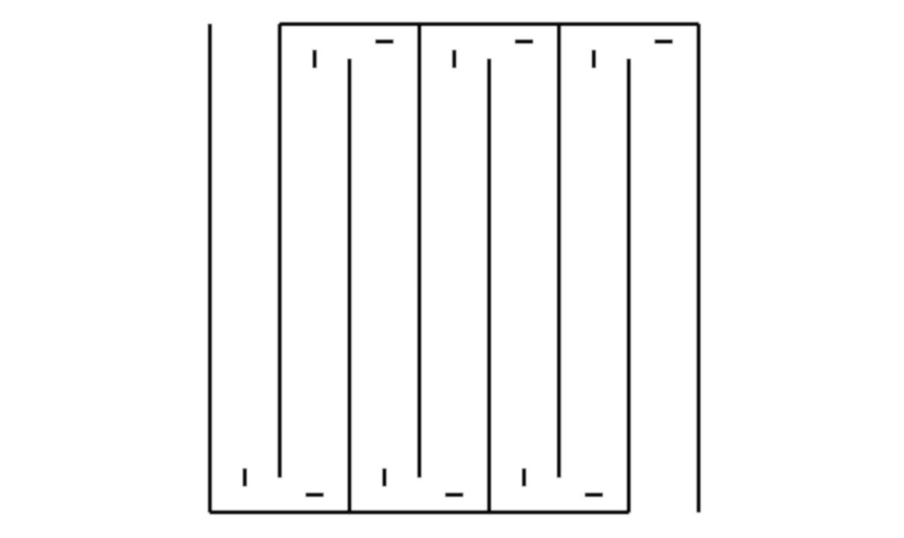

Real life Application: Use on Farms
Goal
Save trip report w/ sensor and time data
GUI for user control
Cover the entirety of a scale field
Provided materials
Tractor frame w/ 2 motors, 2 wheels, and swivel wheel
L298N Motor Controller
BLE Bluetooth module from DSD technology
Ultrasonic distance sensor
MPU9250 Gyroscope
IR Emitter LED and IR receiver
The Project at a Glance
01
/
Introduction

Slide 4
Milestone Overview
Milestone Two
Implement most sensors to allow the tractor to drive forward and perform an emergency stop. Make the tractor drive in a straight path autonomously.
Milestone One
Begin research for the project and outline a plan to stay on track for the rest of the project.
Week 12
Week 6
Week 9
Milestone Four
Week 3
Design and implement a GUI to control the tractor and output data gathered through trip reports.
Milestone Three
Begin interfacing with the tractor using the Bluetooth module. Implement the remaining IR sensor. Complete the autonomous path.
01
/
Introduction

Slide 5
02
Hardware Design

Slide 6
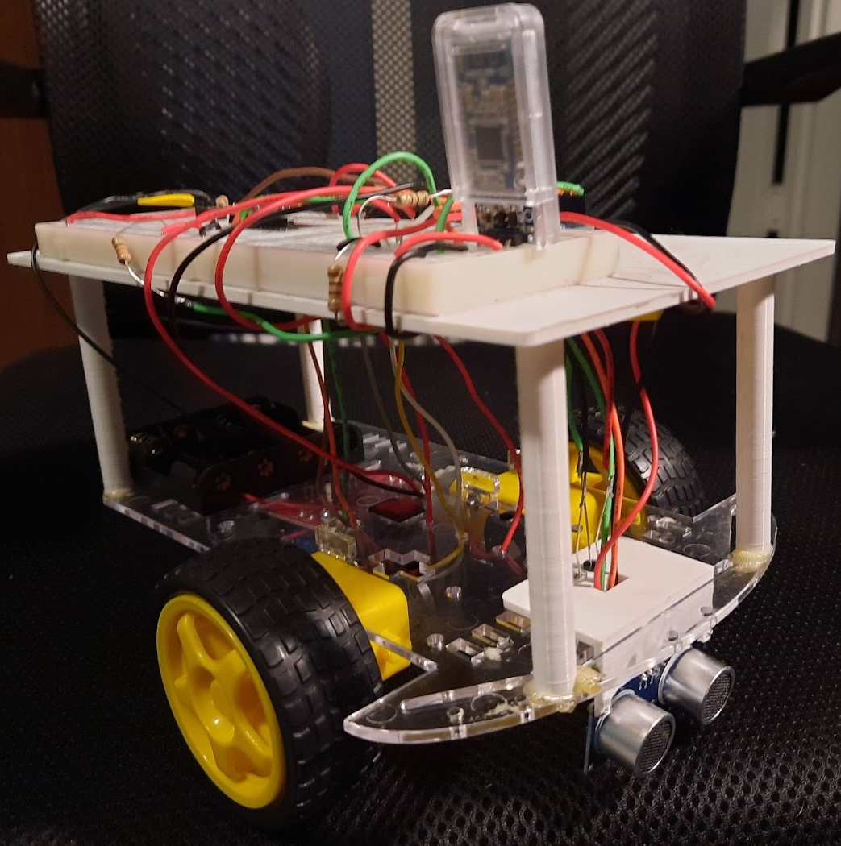
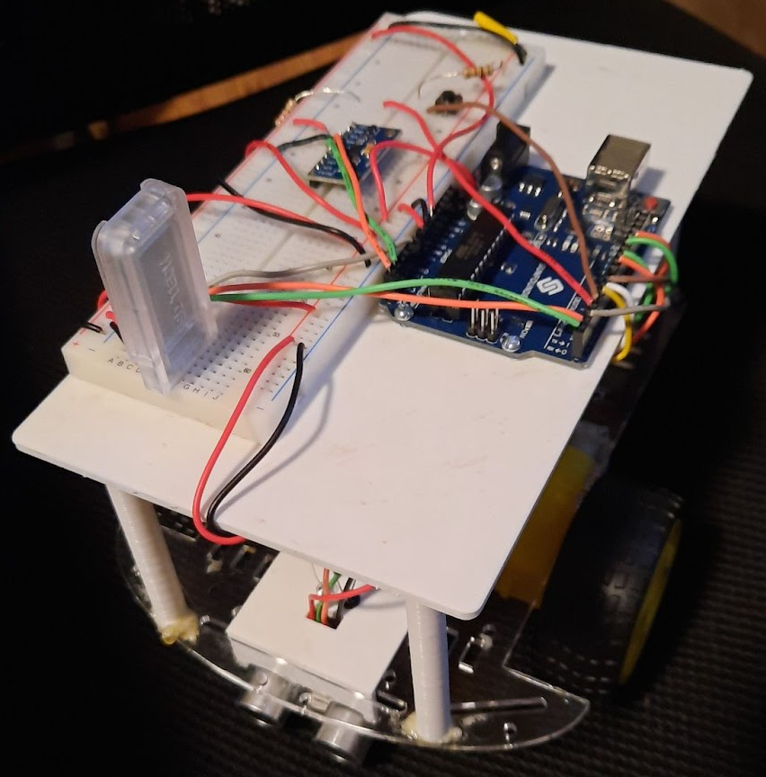
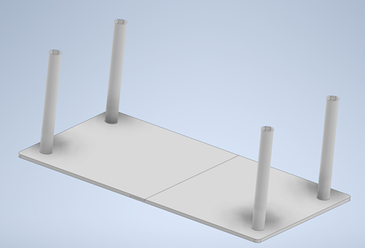
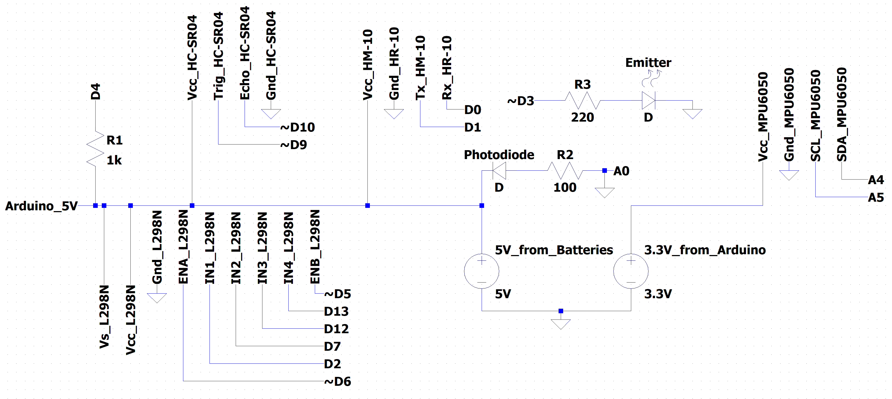
Structural Design and Purpose
Platform for components that wouldn’t fit on the chassis
Raised to allow for easy access to the battery carriage
Wiring run underneath the platform in harnesses
02
/
Hardware Design

Slide 7
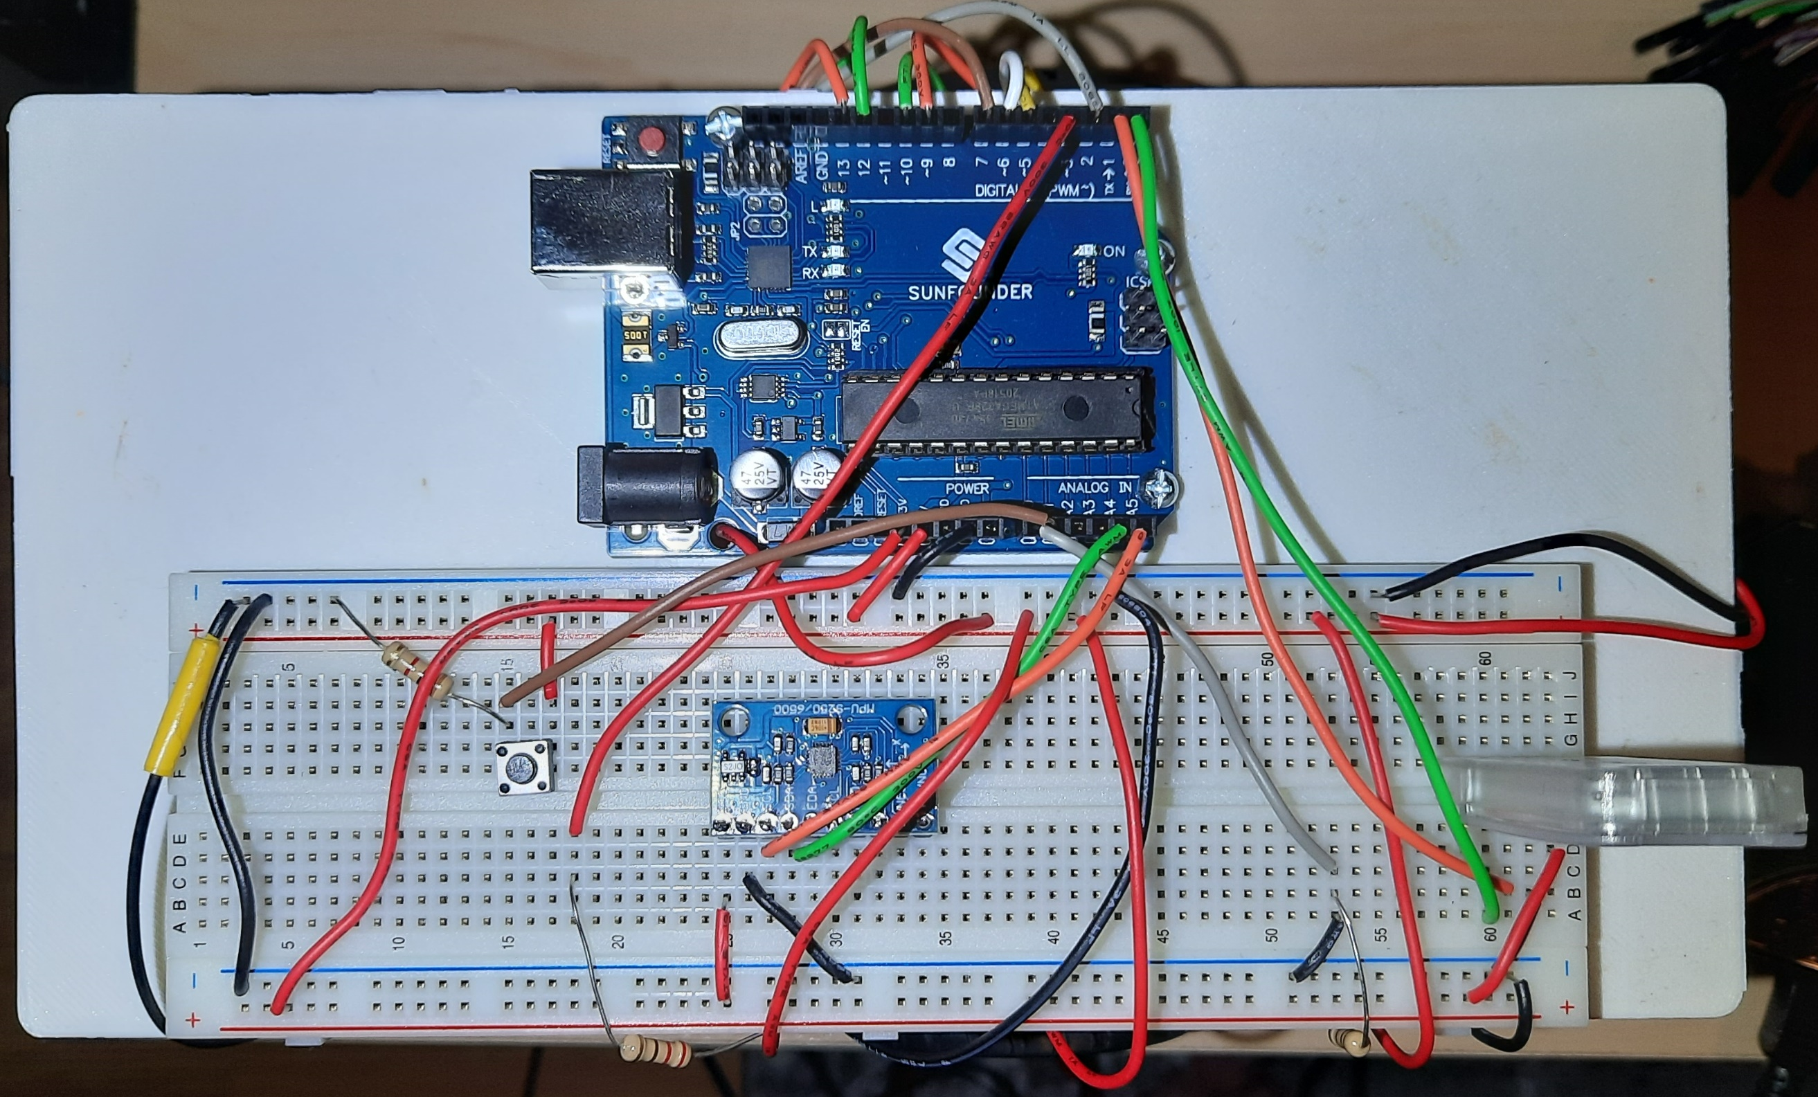
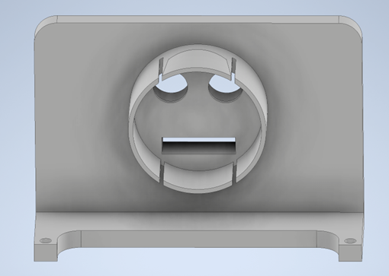
Sensors
Sensor mount that fit in the existing cut outs for the infrared and ultrasonic sensors
Gyroscope and Bluetooth module mounted on the platform
02
/
Hardware Design

Slide 8
03
Software Design

Slide 9
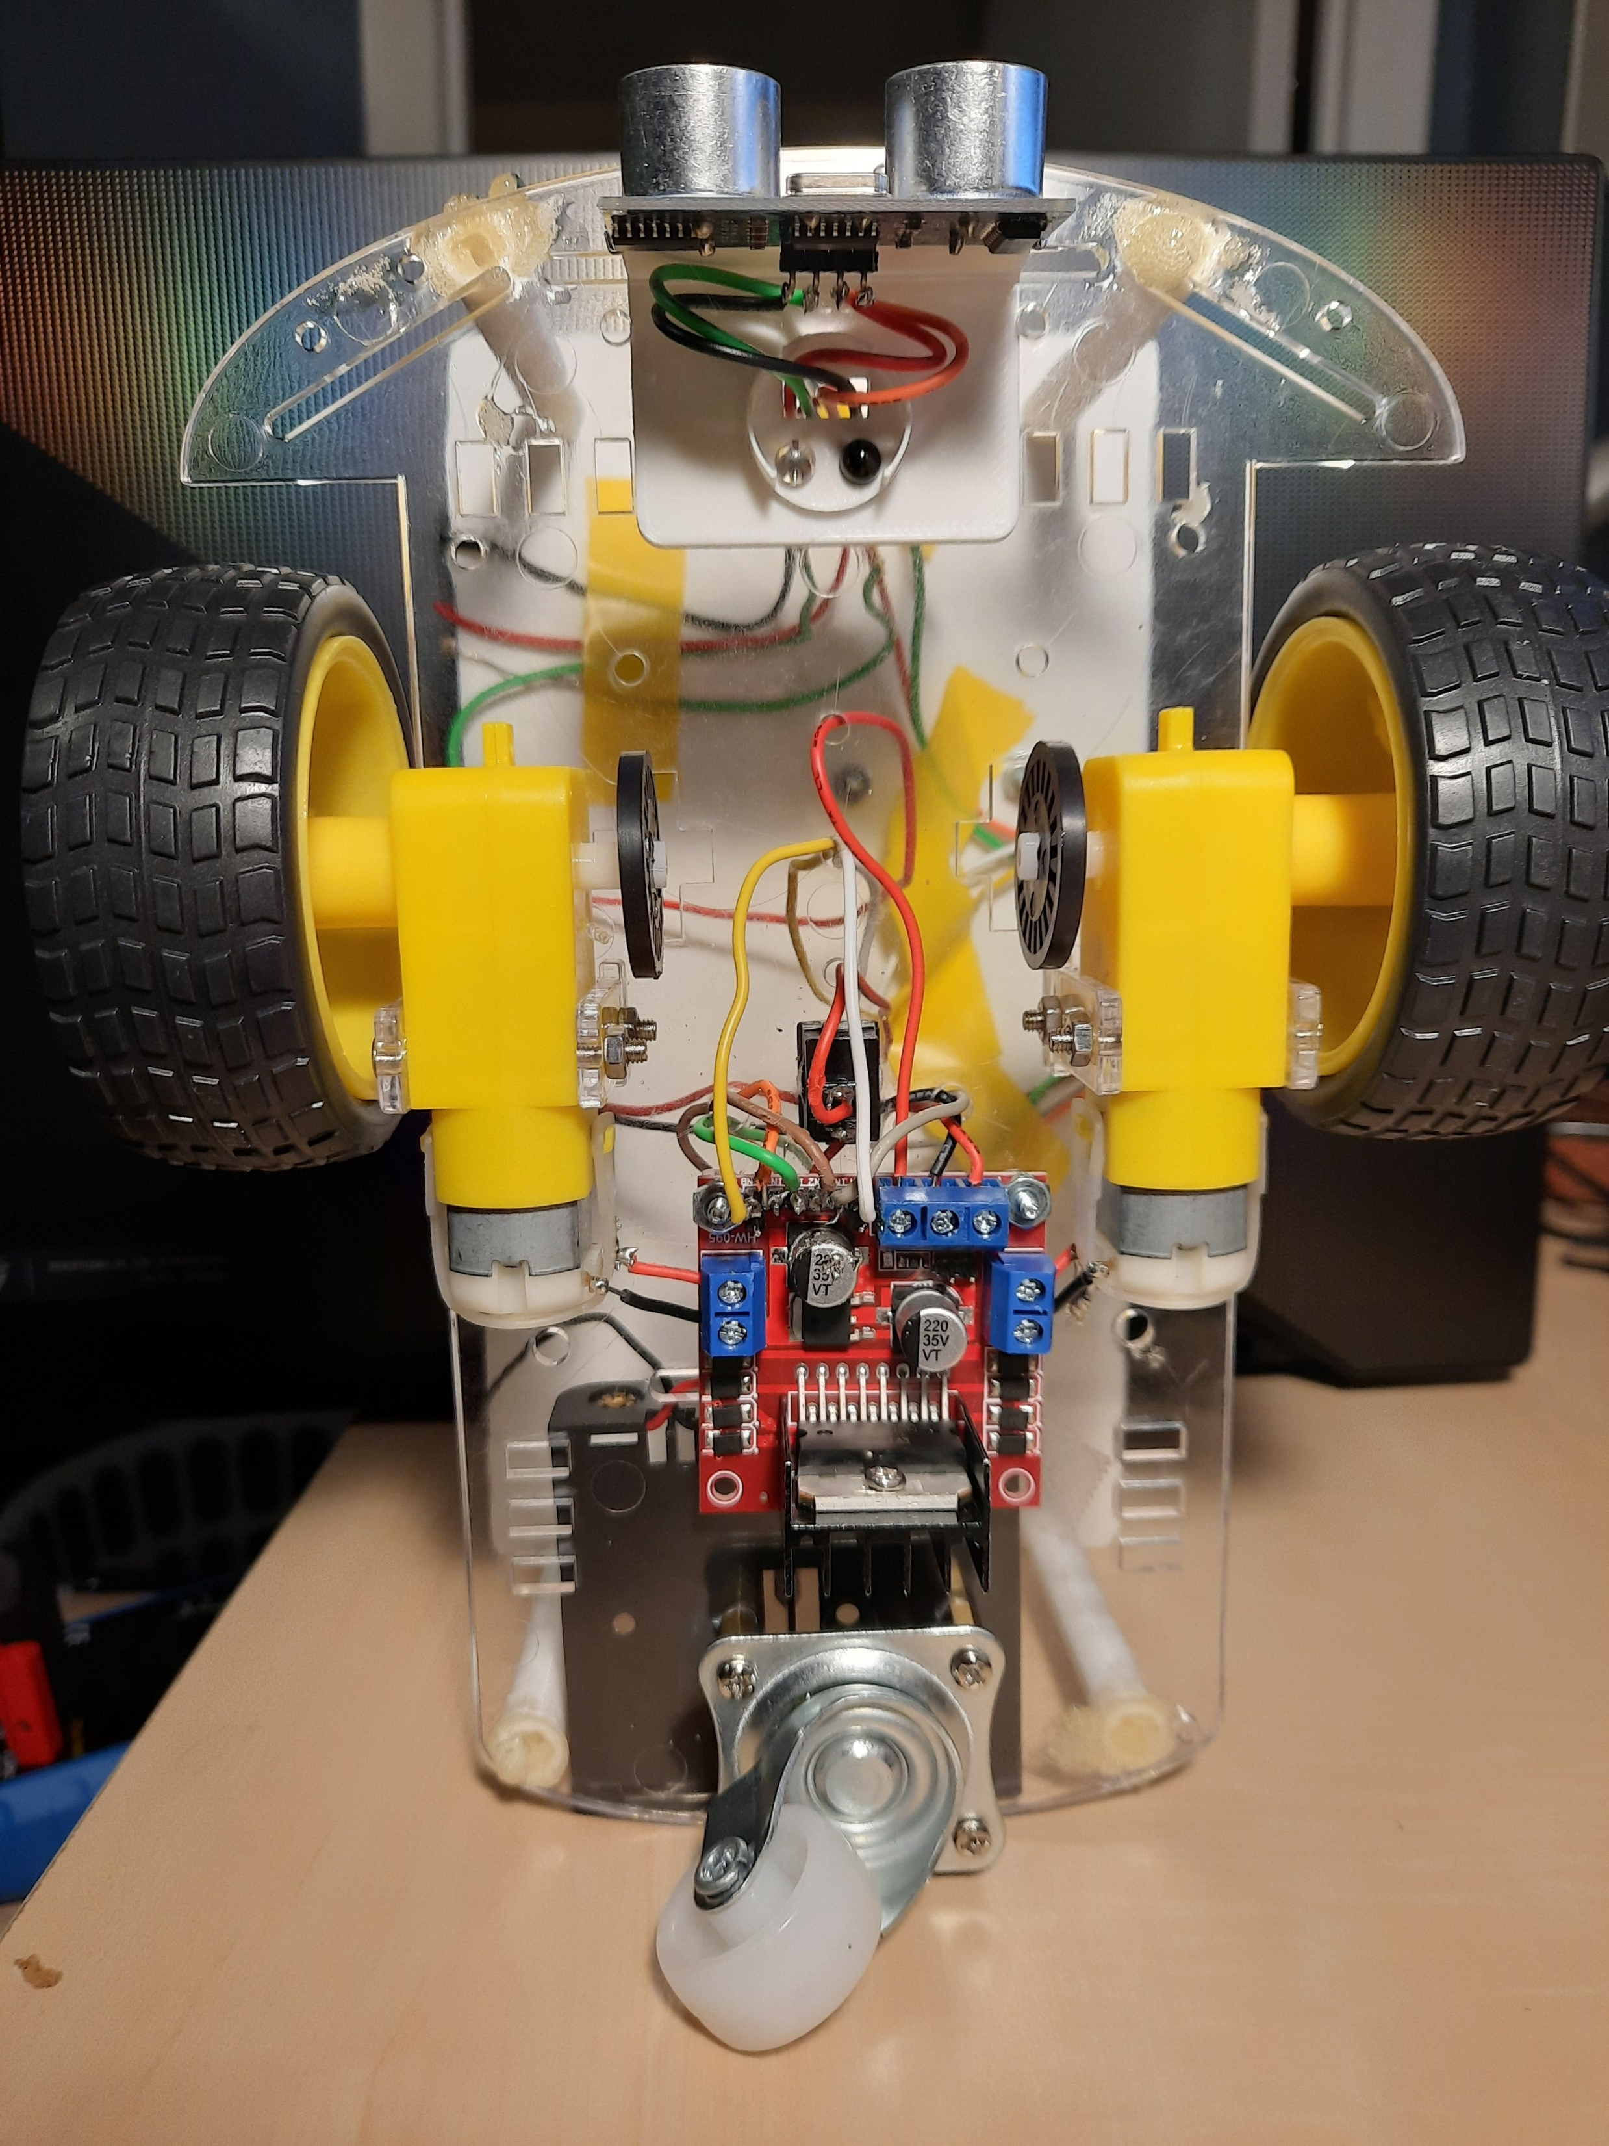
Motor Control
L298N with PWM control for speed
IN1IN2’ = Left Forward
IN3’IN4 = Right Forward
PID loop to control individual motor speed
03
/
Software Design

Slide 10
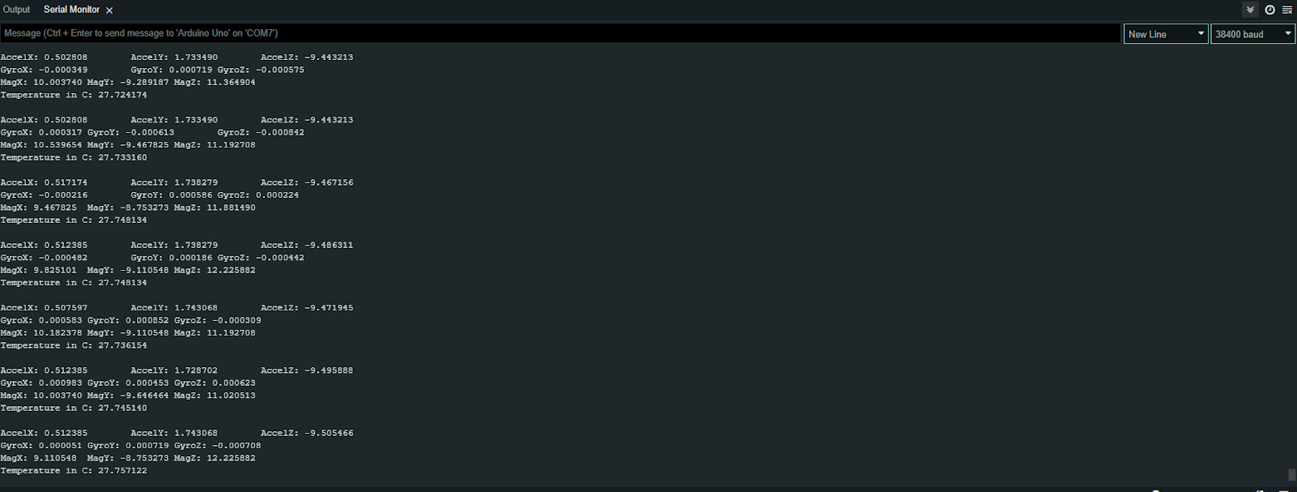
Using MPU6050_light library
Gyroscope code first calculates offsets, then gets the following data every second (9600 bad):
Acceleration
Gyroscope
Magnetometer
Temperature
Data is used to make accurate turns and keep speed regulated in tractor.
Gyroscope
03
/
Software Design

Slide 11
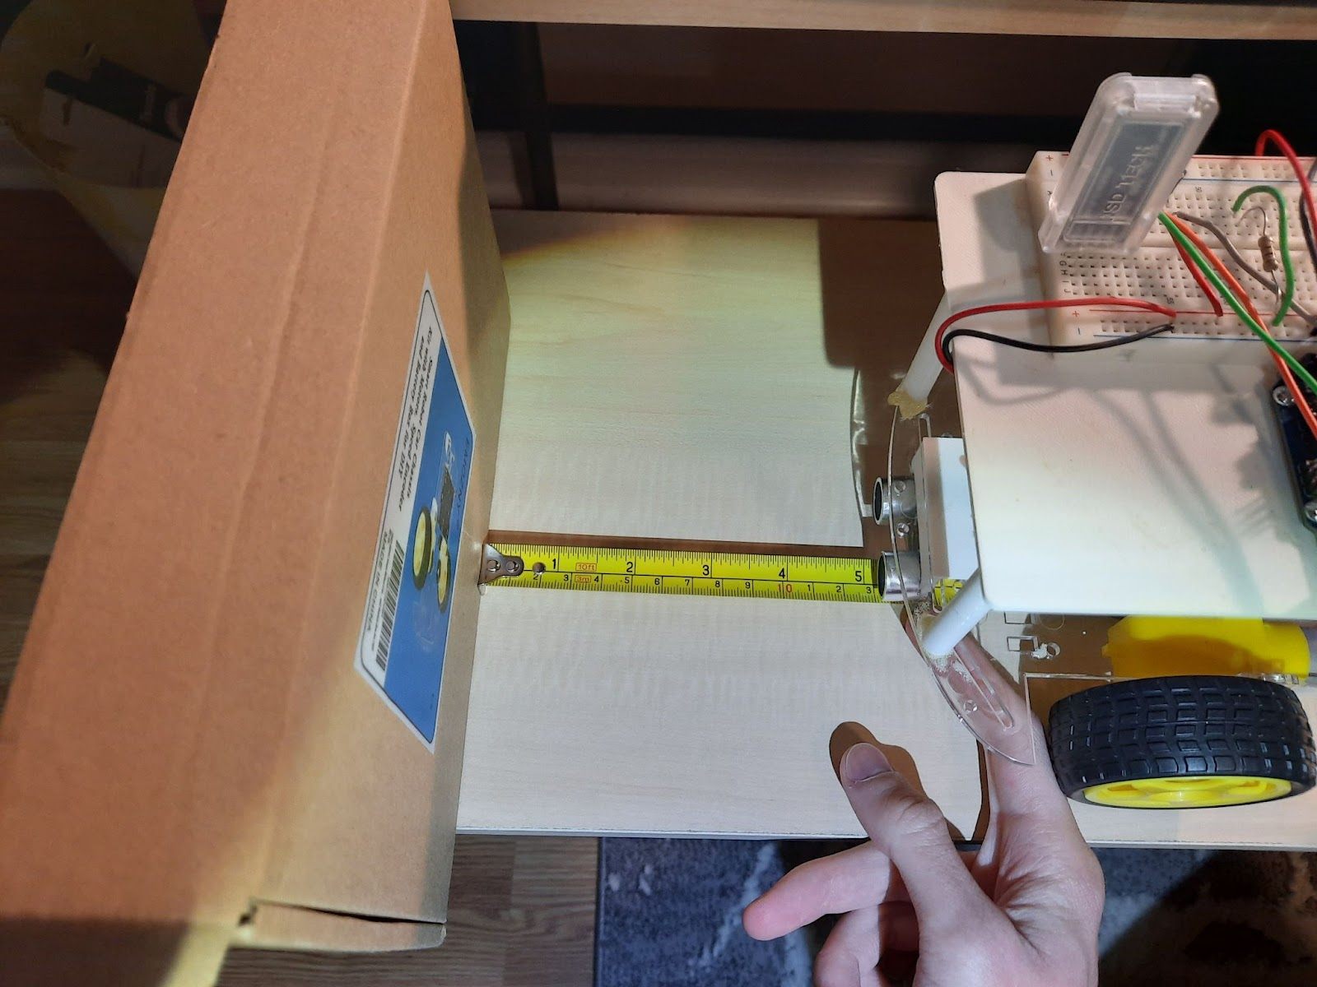
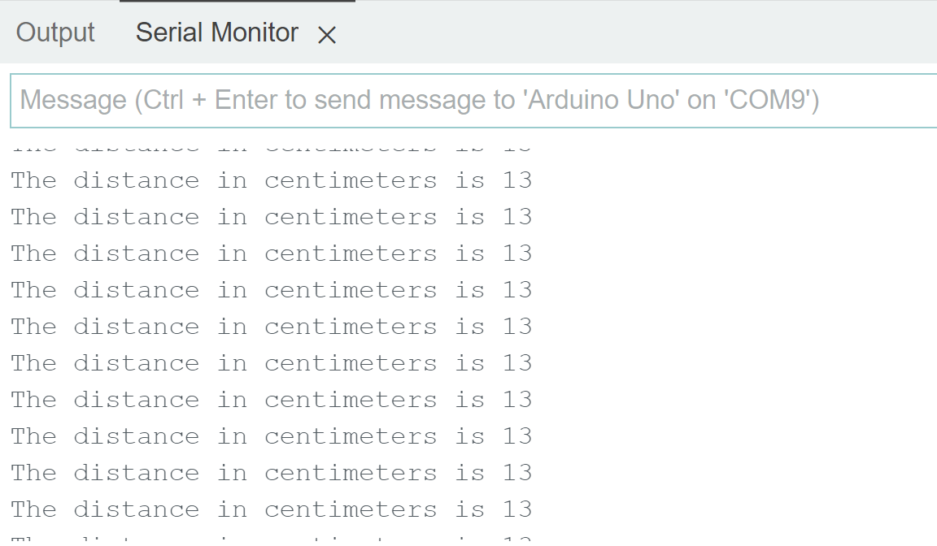
Ultrasonic Sensor
Ultrasonic sensors get pulse duration
Calculates the distance in cm using the pulse time
Used to detect objects and prevent collisions
03
/
Software Design

Slide 12
04
Reflections

Slide 13


Issues Encountered and Solutions
TEAM | SECTION TITLE
Current Draw Issue
I2C Communication Issue
The desired current to run the tractor is about 300mA from the battery carriage, however, only 50mA were measured.
The MPU9250 gyroscope would return special characters or wouldn’t return any data when being tested.
Problem
Problem
The batteries were charged and tested. The team tested new pin assessments.
The team switched to the MPU6050 light library.
Solution
Solution
04
/
Reflections

Slide 14
Planned Approach for the Future
Week 8
Week 9
Week 10
Week 11
Week 12
IR Sensor Development
Turning Implementation
Bluetooth Module Development
GUI Development
Final Adjustments
04
/
Reflections

Slide 15
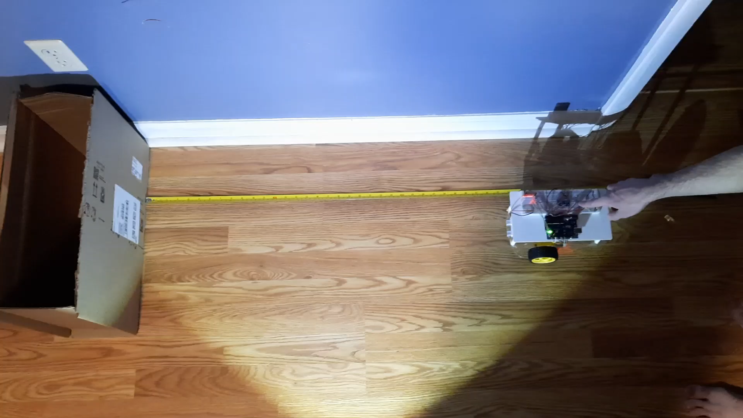

Slide 16
Questions?

